Slide 1
What Is SDLC? Benefits, Phases, Comparisons
Name: Akhmedov Yusufjon Muhammad ugli
Major: Computer Engineering
Student Number: 202438404
Due date: 2025.03.31
Submission date: 2025.03.28

Slide 2
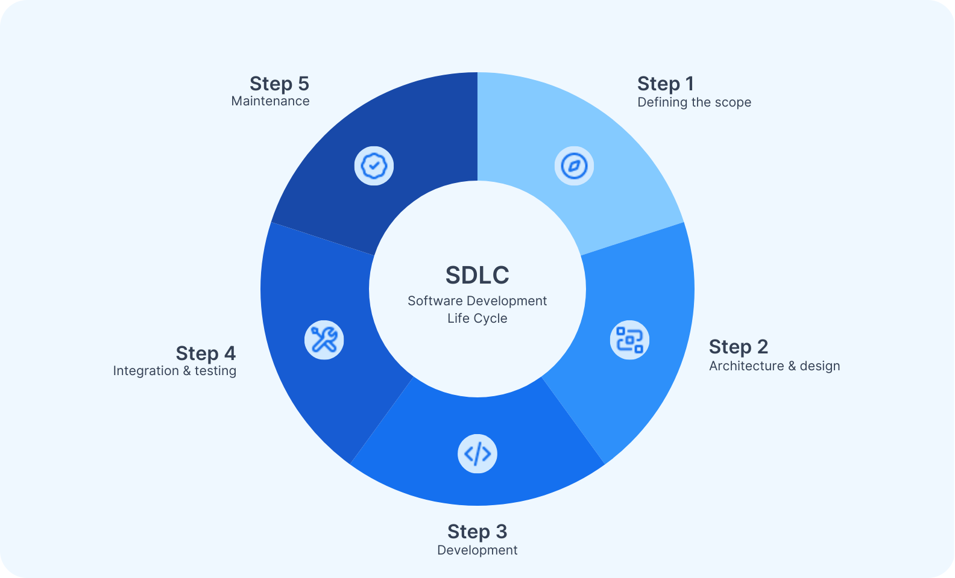
What Is SDLC?
SDLC, or Software Development Life Cycle, is a structured approach to software development. This approach outlines the steps to create high-quality software, from initial planning to maintenance.
Customer expectations
Project requirements

Slide 3
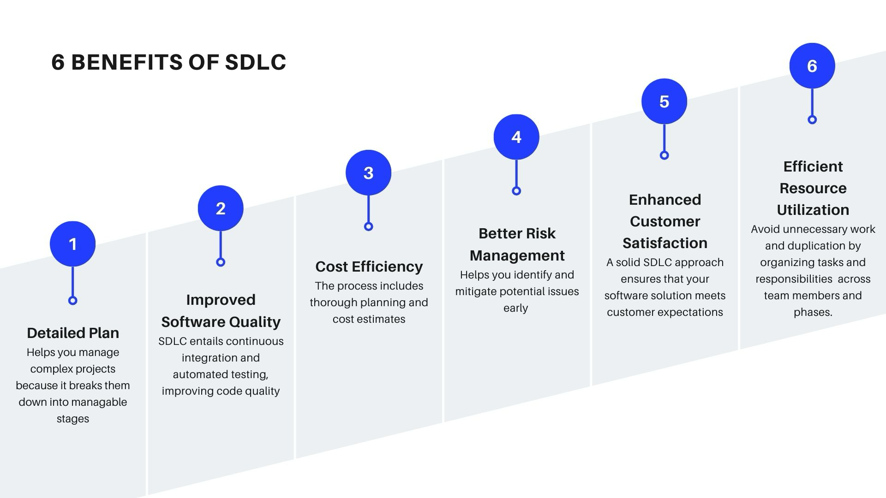

Slide 4
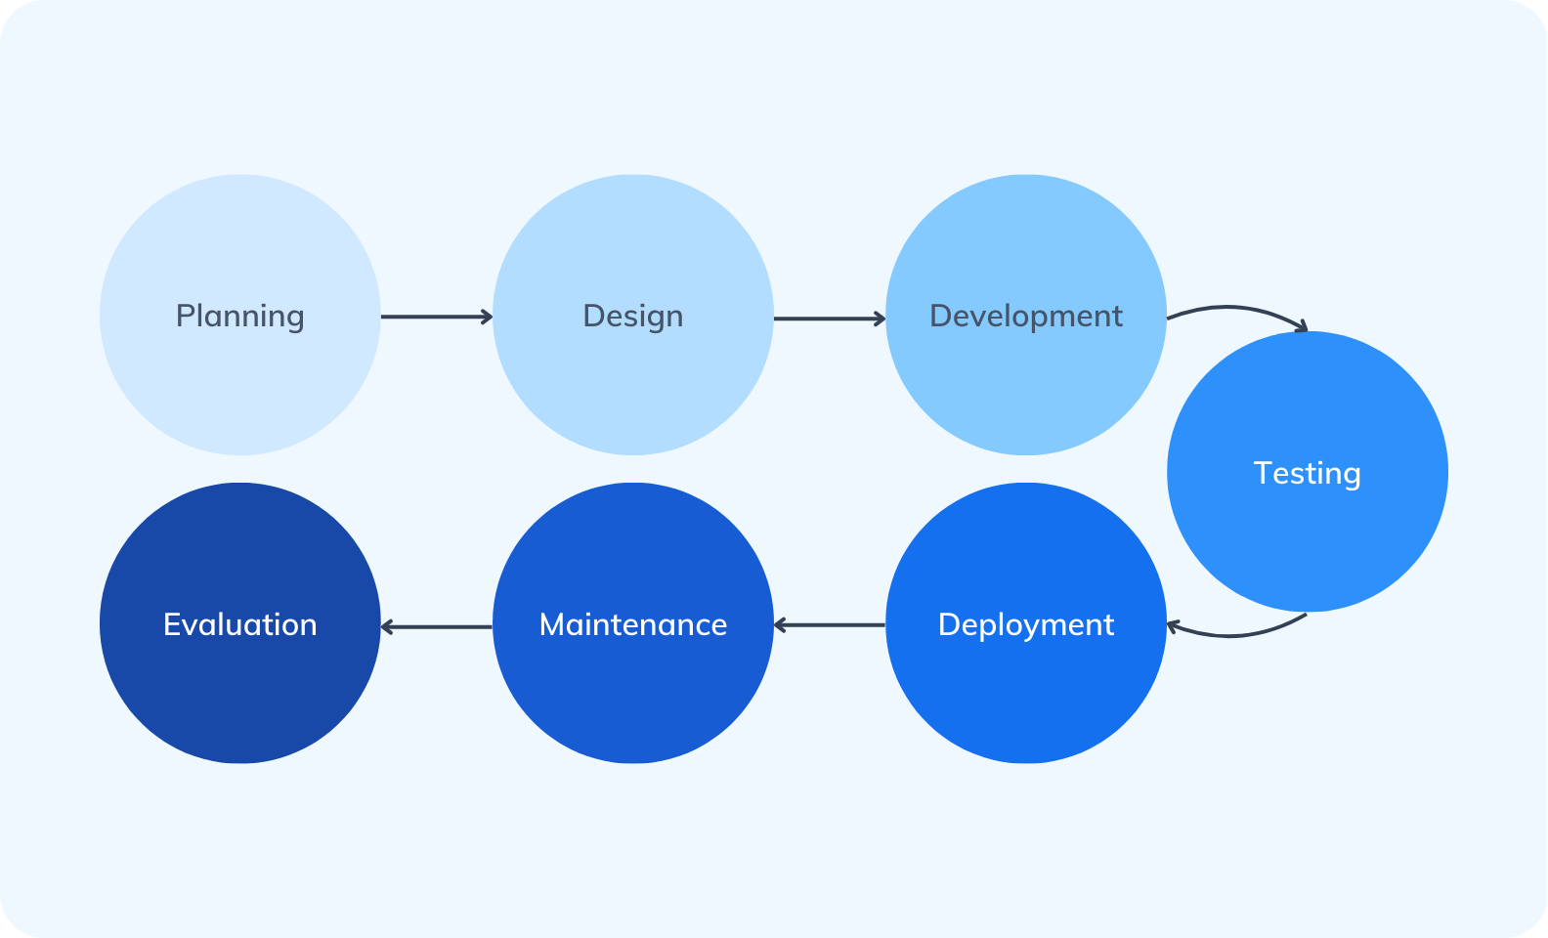
7 SDLC Phases + How to Tackle Them
“These phases can be followed using different models like Waterfall (step-by-step), Agile (iterative and flexible), or a Hybrid approach (combining both).”

Slide 5
SDLC Models
5 general model types

Slide 6
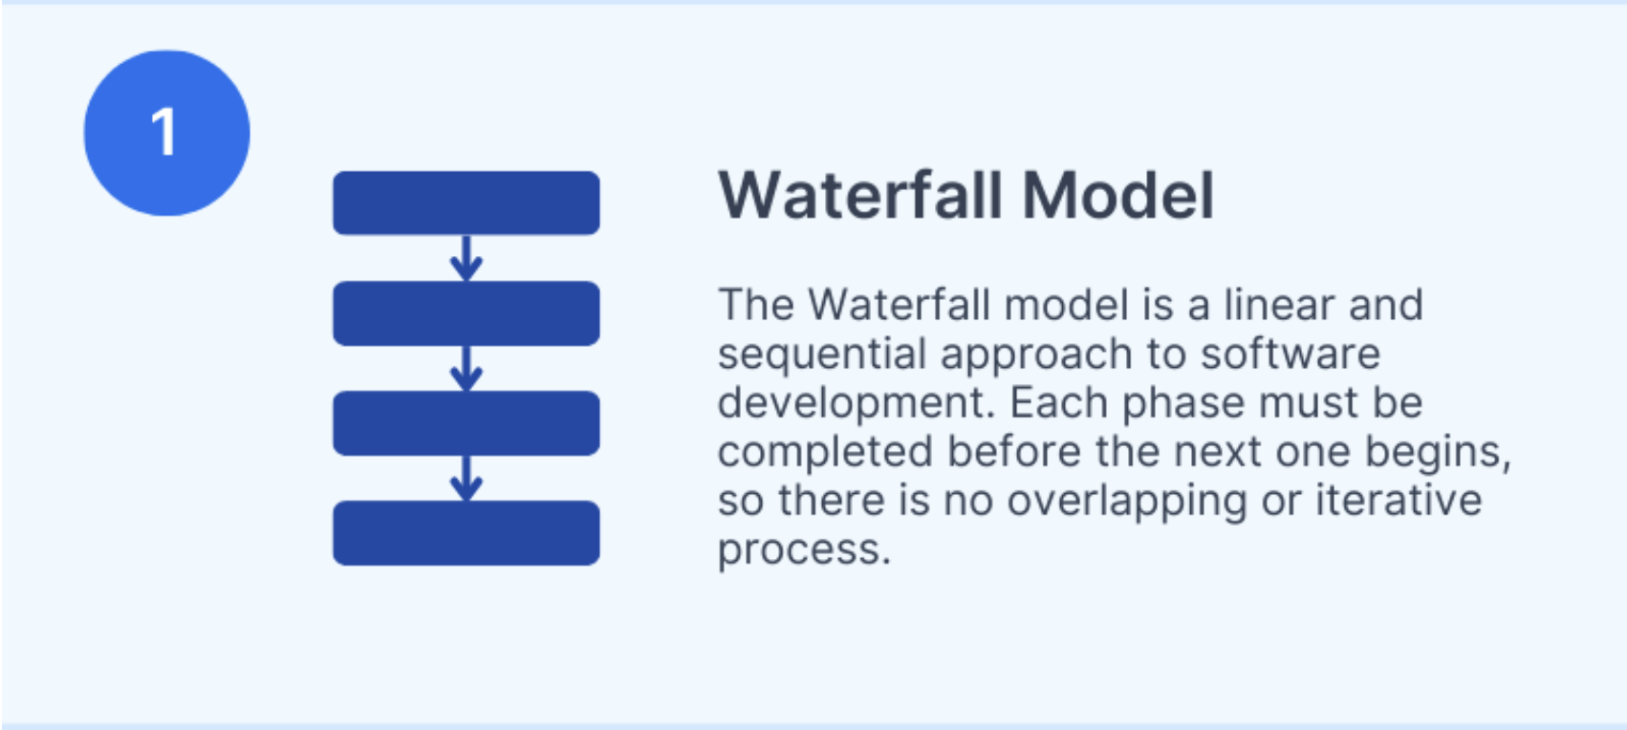

Slide 7
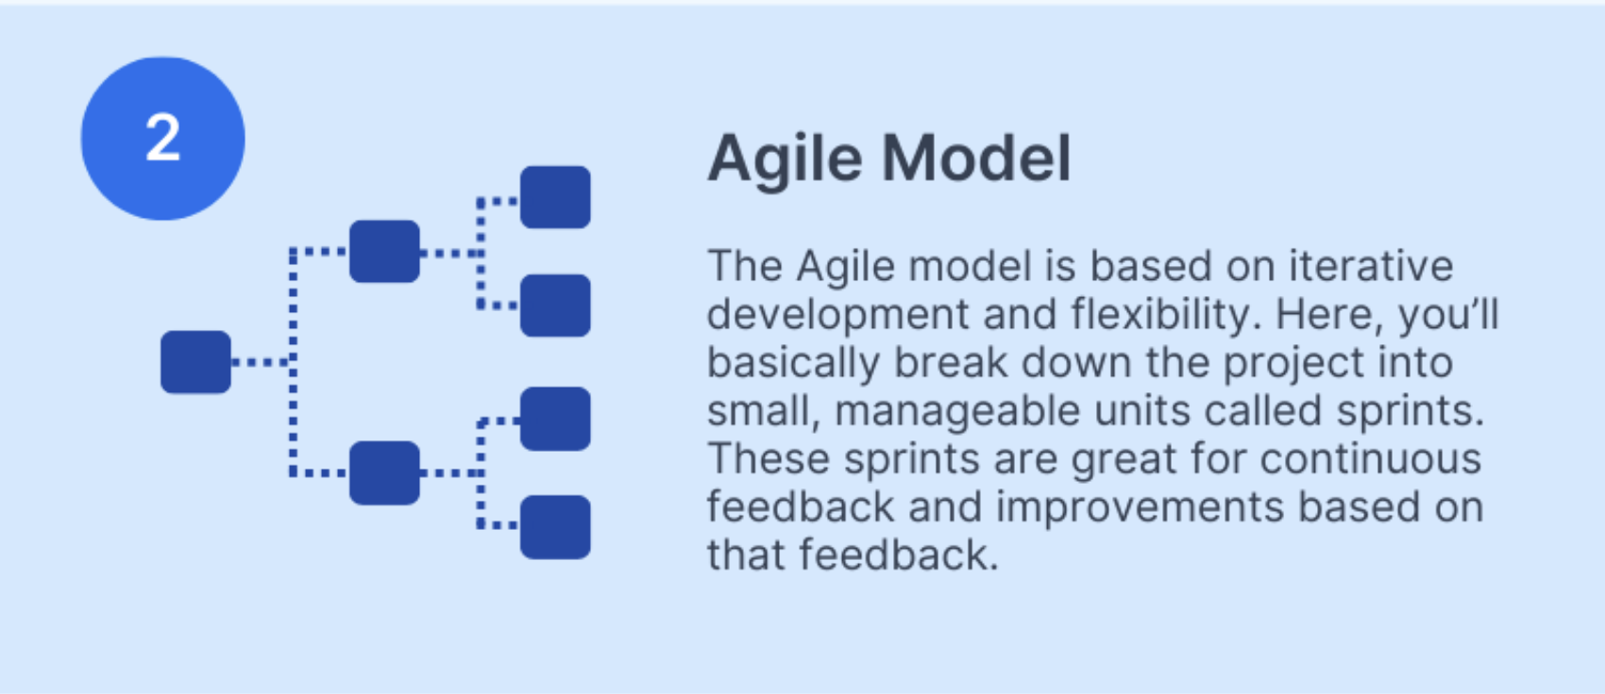

Slide 8
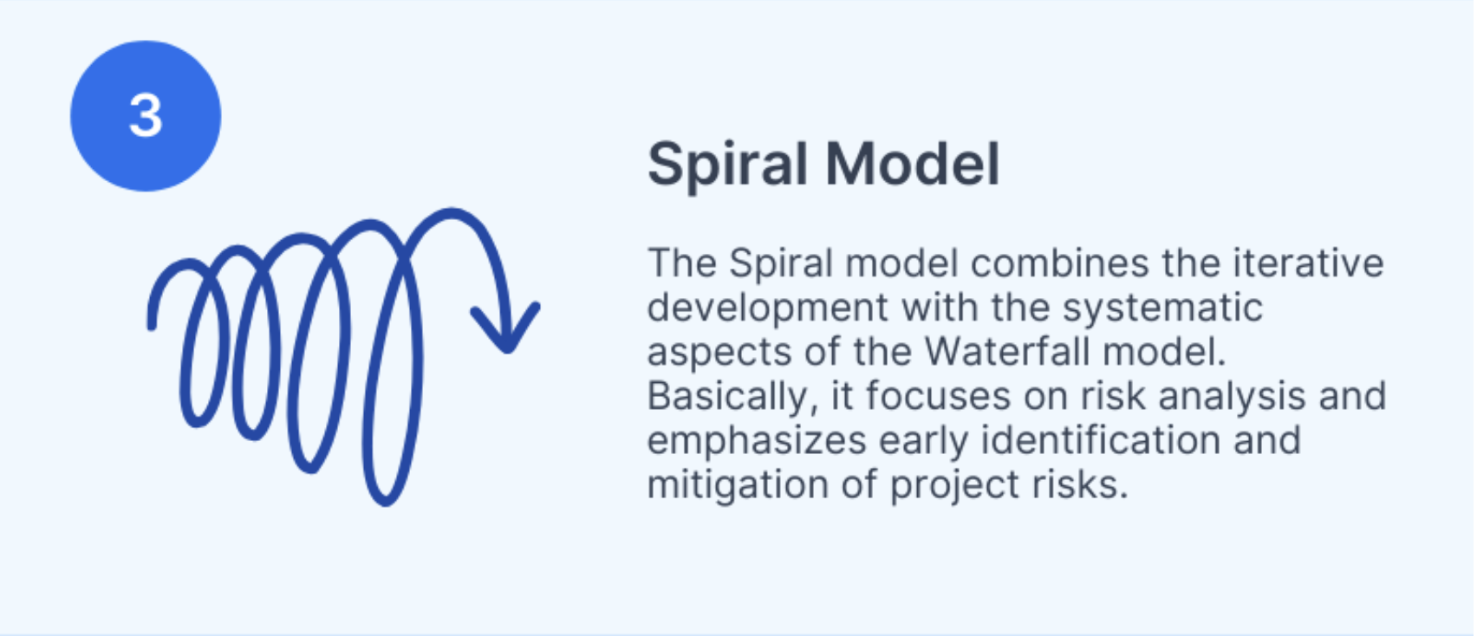

Slide 9
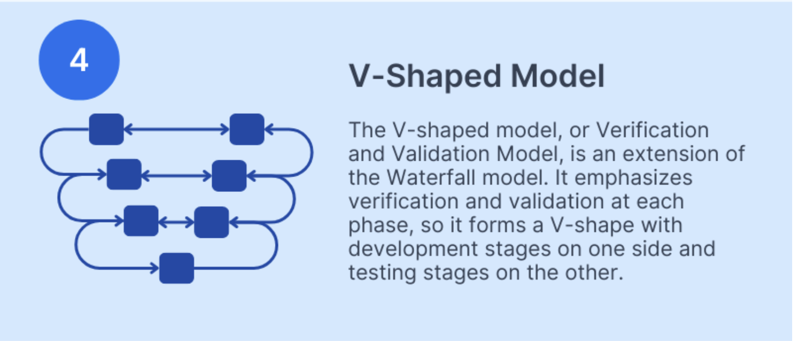

Slide 10
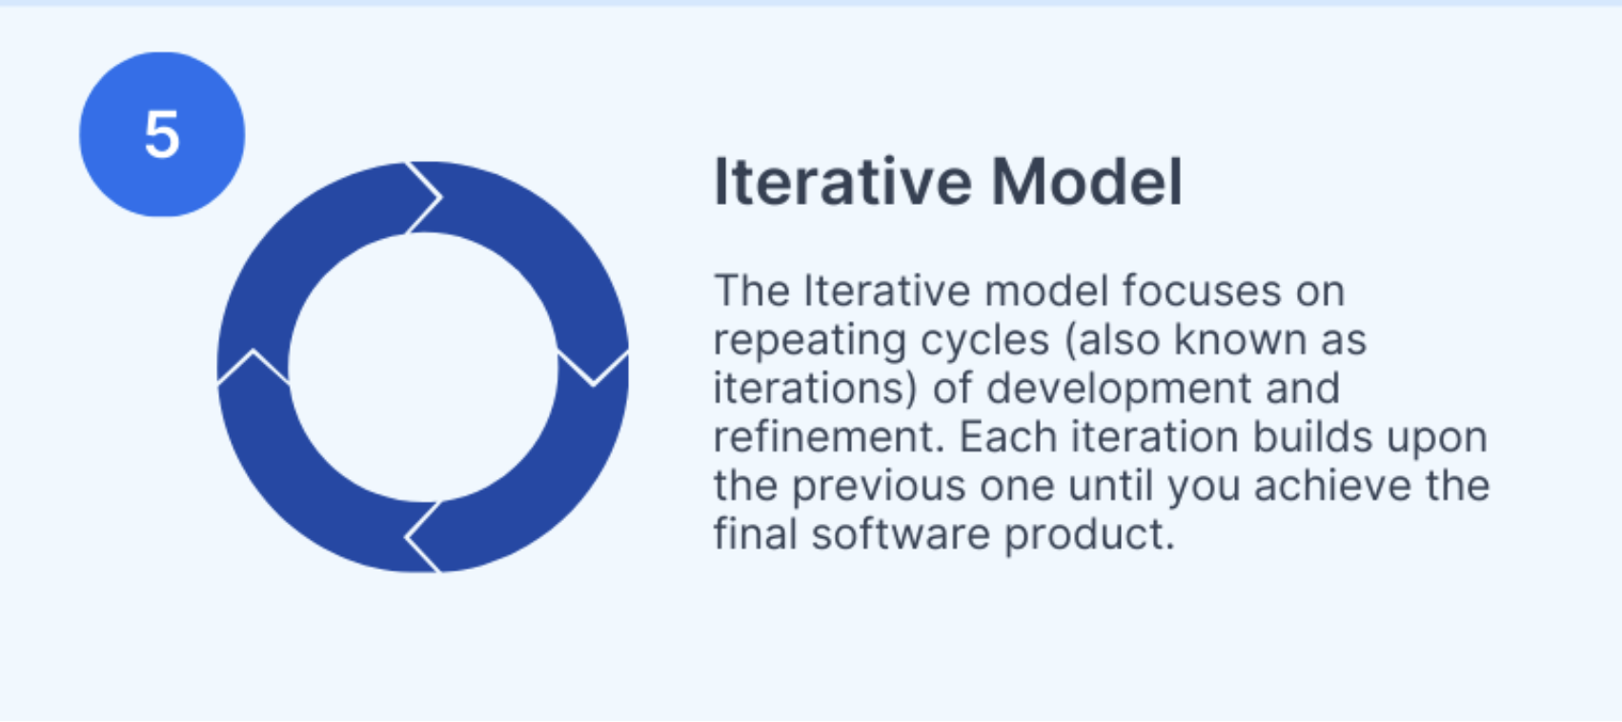

Slide 11
SDLC vs. Other Lifecycle Management Methodologies
SDLC vs. Agile
SDLC is a structured approach that follows a sequential process, while Agile emphasizes flexibility and iterative progress.
SDLC vs. Lean
have different focuses. SDLC is a detailed and structured approach to software development, while Lean focuses on optimizing efficiency and minimizing waste.
SDLC vs. ITIL
SDLC and ITIL (Information Technology Infrastructure Library) are both solid methodologies for managing IT processes, but they have different scopes and focuses. SDLC focuses on software development, while ITIL provides a framework for delivering IT services.
SDLC vs. DevOps
SDLC and DevOps both aim to streamline the software development process, but they focus on different aspects. SDLC is more about the development lifecycle, while DevOps integrates development and operations to improve deployment and maintenance.
SDLC vs. Six Sigma
SDLC and Six Sigma are methodologies that serve different purposes. SDLC is a framework for managing software development, whereas Six Sigma is a data-driven approach to improving processes and quality.

Slide 12
Thanks!
Questions about SDLC?
Source

